Slide 1
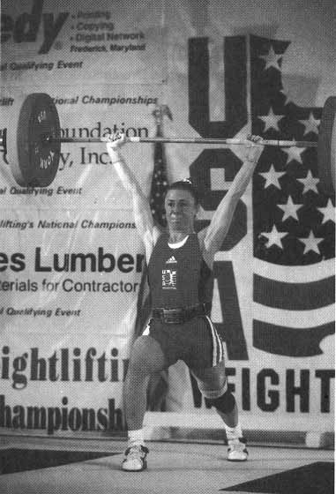
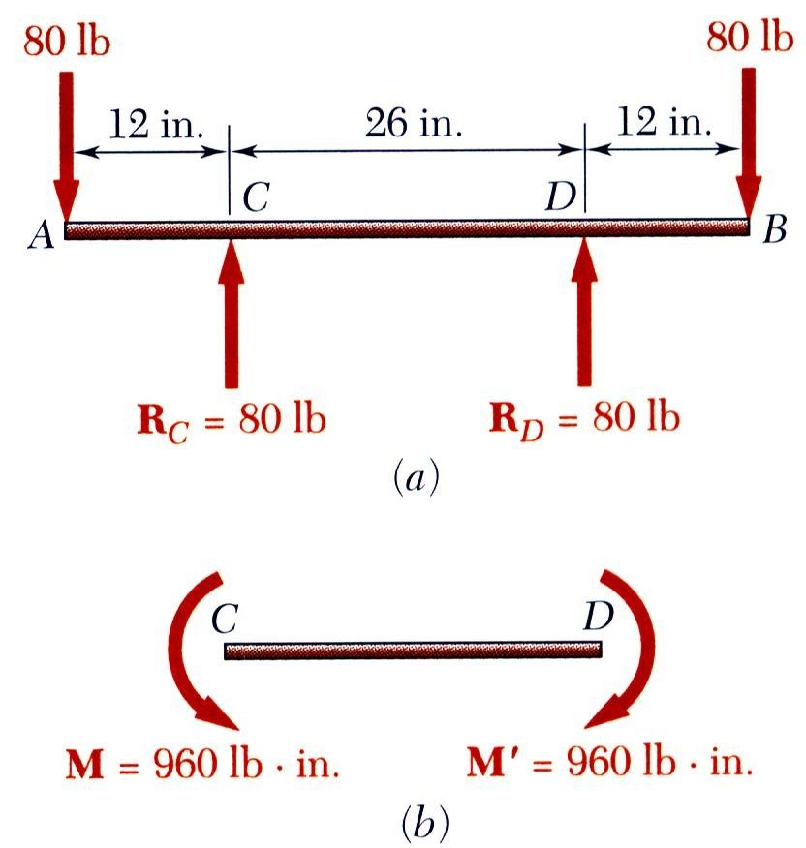
Pure Bending
Pure Bending: Prismatic members subjected to equal and opposite couples acting in the same longitudinal plane

Slide 2
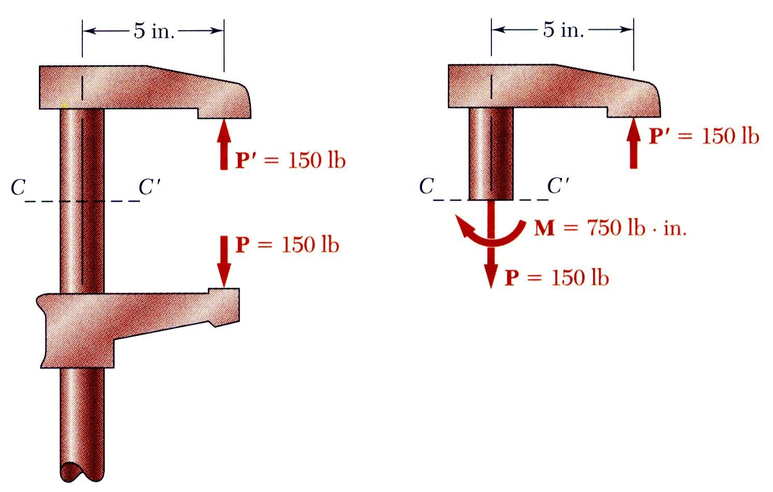
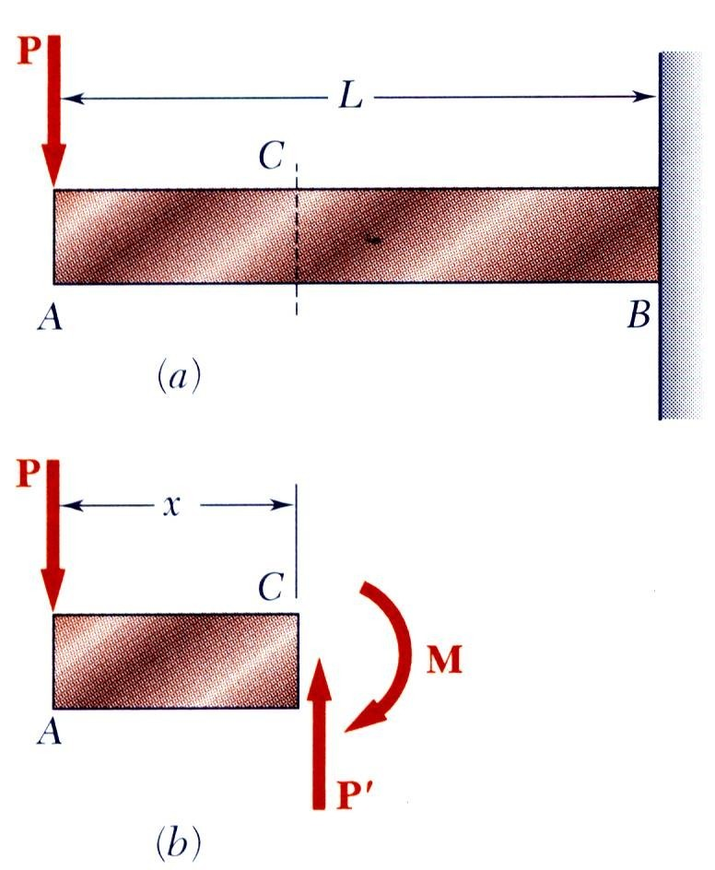
Other Loading Types
Eccentric Loading: Axial loading which does not pass through section centroid produces internal forces equivalent to an axial force and a couple
Transverse Loading: Concentrated or distributed transverse load produces internal forces equivalent to a shear force and a couple
Principle of Superposition: The normal stress due to pure bending may be combined with the normal stress due to axial loading and shear stress due to shear loading to find the complete state
of stress.

Slide 3
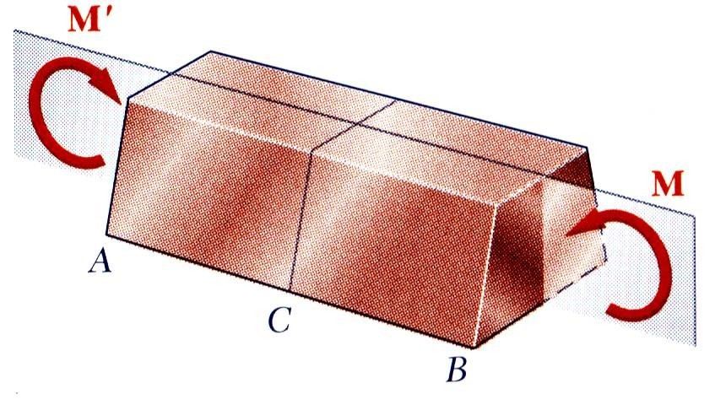
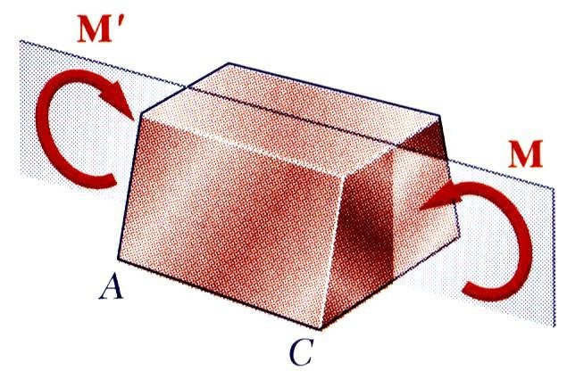
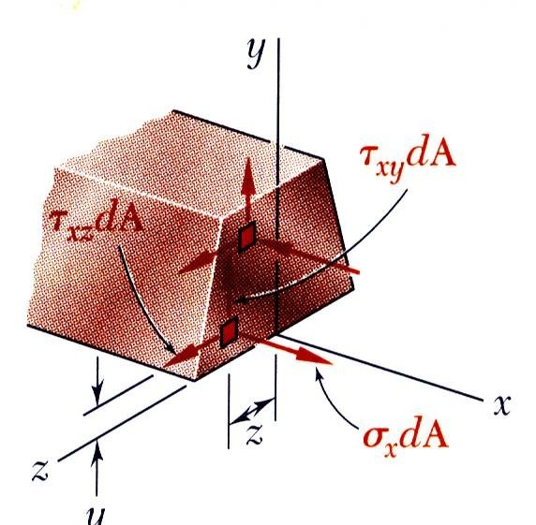
Symmetric Member in Pure Bending
Internal forces in any cross section are equivalent to a couple. The moment of the couple is the section bending moment.
From statics, a couple M consists of two equal and opposite forces.
The sum of the components of the forces in any direction is zero.
The moment is the same about any axis perpendicular to the plane of the couple and zero about any axis contained in the plane.
These requirements may be applied to the sums of the components and moments of the statically indeterminate elementary internal forceFs_{x}. = ∫σ _{x} dA = 0
M _{y} = ∫ zσ _{x} dA = 0
M _{z} = ∫ − yσ _{x} dA = M

Slide 4
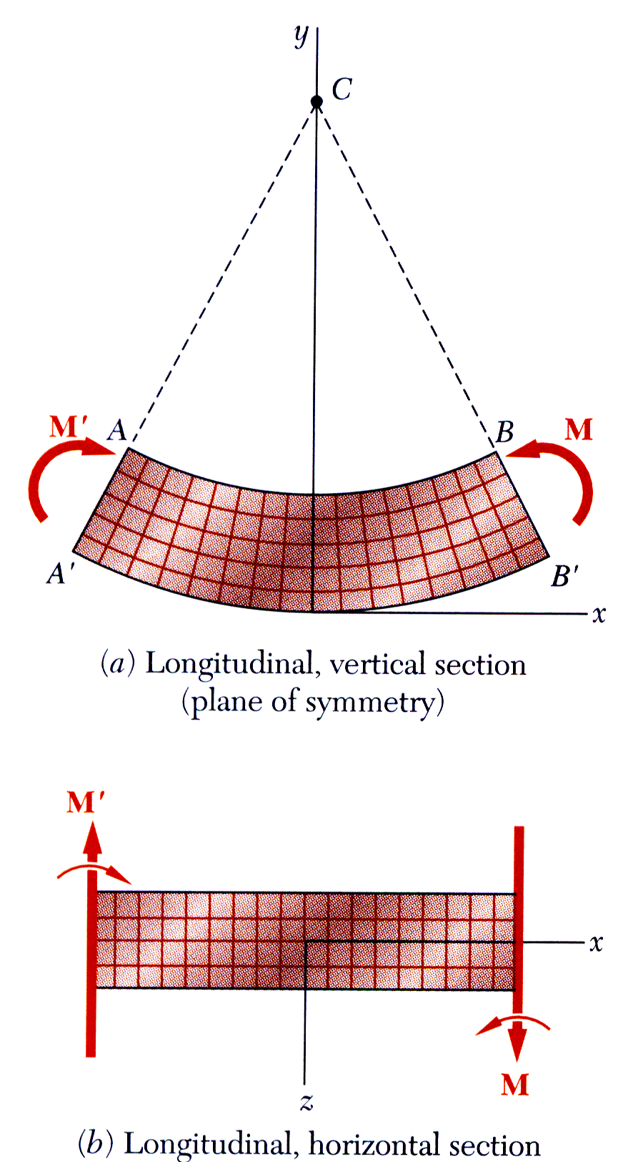
Bending Deformations
Beam with a plane of symmetry in pure bending:
member remains symmetric
bends uniformly to form a circular arc
cross-sectional plane passes through arc center and remains planar
length of top decreases and length of bottom increases
a neutral surface must exist that is parallel to the upper and lower surfaces and for which the length does not change
stresses and strains are negative (compressive) above the neutral plane and positive (tension) below it

Slide 5
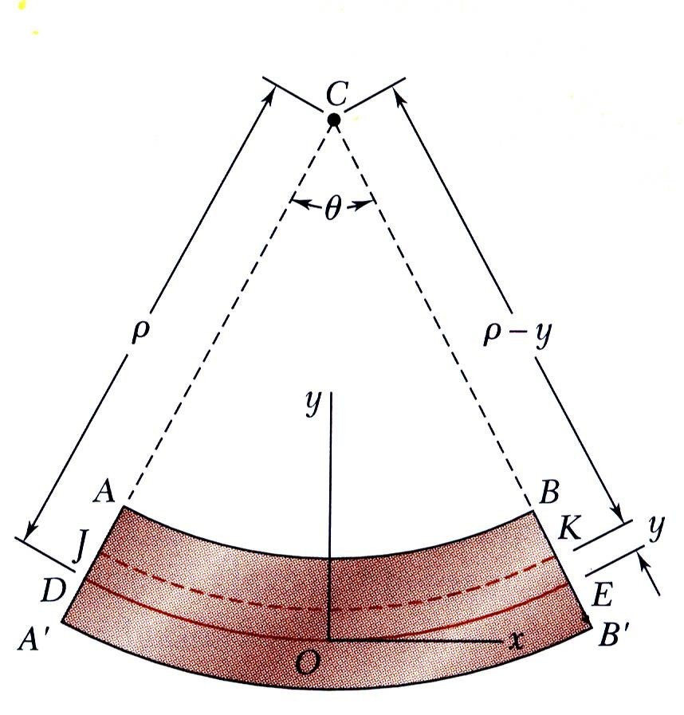
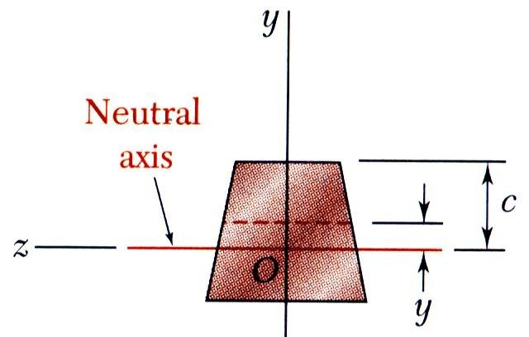
Strain Due to Bending
Consider a beam segment of length L.
After deformation, the length of the neutral surface remains L. At other sections,
L′= ( ρ − y)θ
δ = L′− L = ( ρ − y)θ − ρθ = − yθ
ε _{x} = ^{δ} = − ^{yθ} = − ^{y} (strain varies linearly)
L ρθ ρ
ε_{m} = ^{c} or ρ = ^{c}
ρ ε_{m}
ε _{x} = − ^{y} ε_{m}
c

Slide 6
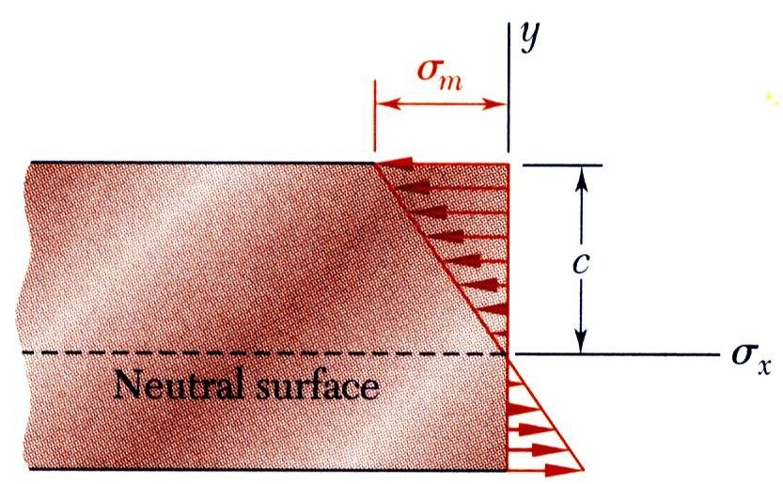
Stress Due to Bending
For a linearly elastic material,
σ _{x} = Eε _{x} = − ^{y} Eε_{m}
c
(stress varies linearly)
= − ^{y} σ _{m}
c
For static equilibrium,
For static equilibrium,
F_{x} = 0 = ∫σ _{x} dA = ∫ − ^{y} σ _{m} dA
y c
c
∫ x ∫
⎛
σ
⎞
dA
M = ( − yσ dA) = ( − y) −
⎜
m
⎟
⎝
⎠
0 = − ^{σ m} ∫ y dA
c
First moment with respect to neutral plane is zero. Therefore, the neutral surface must pass through the section centroid.
M = ^{σ m} ∫ y² dA = ^{σ m I} c c
₌ Mc ₌ M
I S
σ
m
y
Substituting σ _{x} = − _{c} σ _{m}
σ _{x} = − ^{My}
I

Slide 7
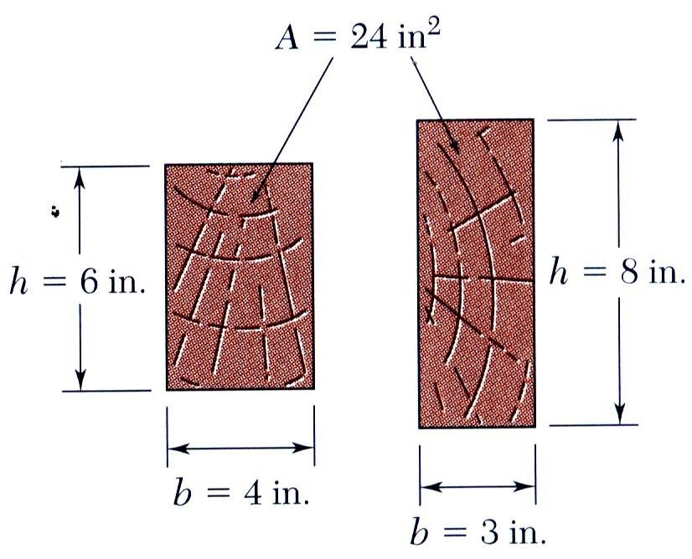
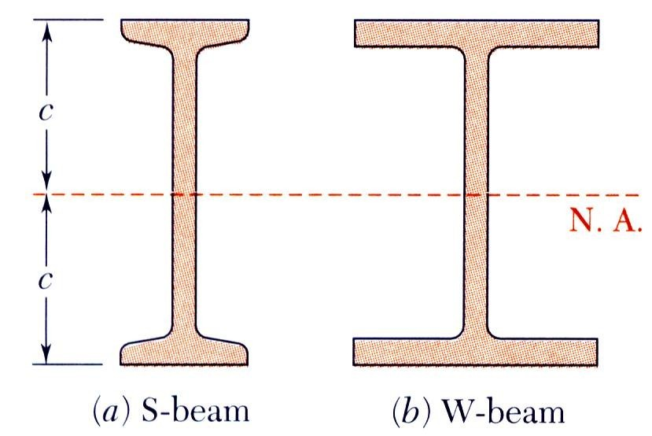
Beam Section Properties
The maximum normal stress due to bending,
_{σ m =} Mc ₌ M
I S
I = section moment of inertia
S = ^{I} = section modulus
c
A beam section with a larger section modulus will have a lower maximum stress
Consider a rectangular beam cross section,
I
1 _{bh}3
3
S = = ¹² = ¹ bh = ¹ Ah
c h 2
6 6
Between two beams with the same cross sectional area, the beam with the greater depth will be more effective in resisting bending.
Structural steel beams are designed to have a large section modulus.

Slide 8
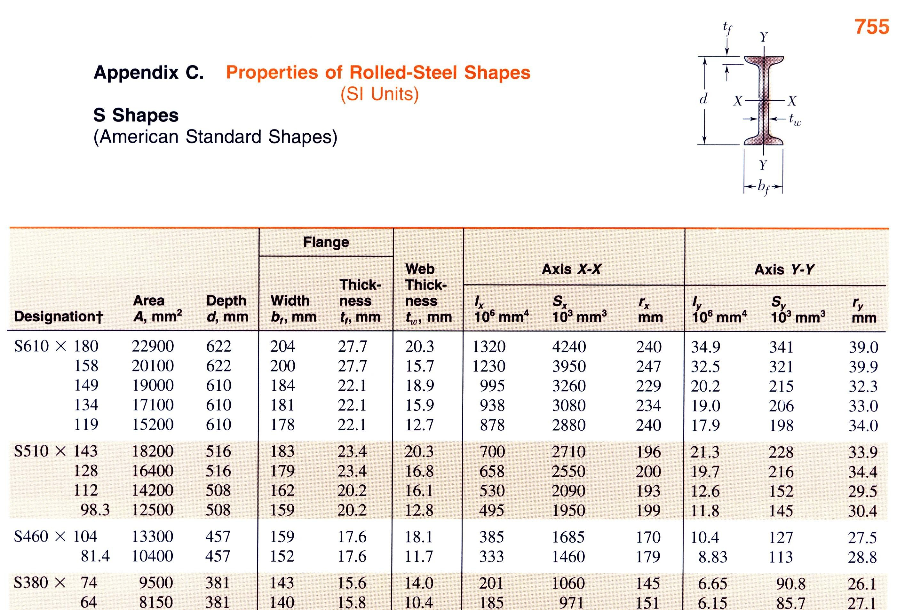
Properties of American Standard Shapes

Slide 9
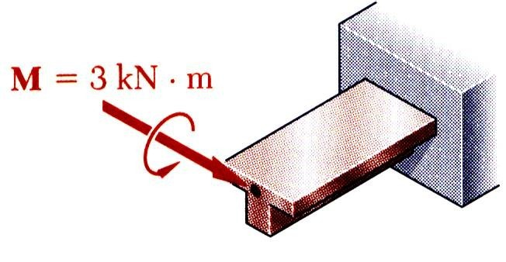
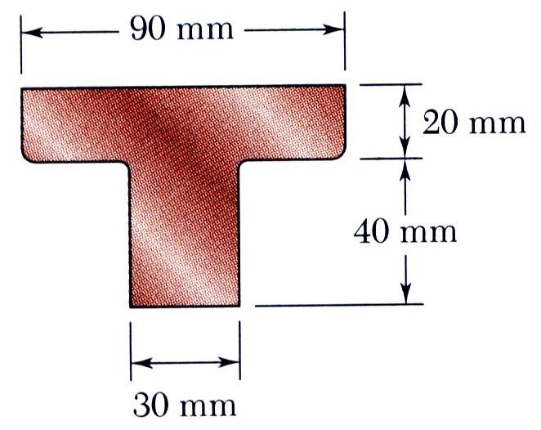
Sample Problem 4.2
SOLUTION:
Based on the cross section geometry, calculate the location of the section centroid and moment of inertia.
_{Y =} ∑ yA
I_{x′}= ∑ (I + Ad ² )
∑ A
Apply the elastic flexural formula to find the maximum tensile and compressive stresses.
_{σ m =} Mc
I
A cast-iron machine part is acted upon by a 3 kN-m couple. Knowing E = 165 GPa and neglecting the effects of fillets, determine (a) the maximum tensile and compressive stresses, (b) the radius of curvature.
Calculate the curvature
1 ₌ M
ρ EI

Slide 10
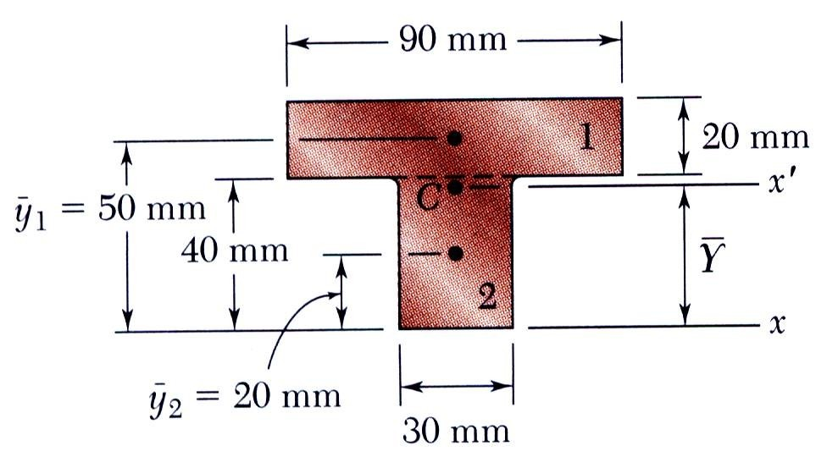
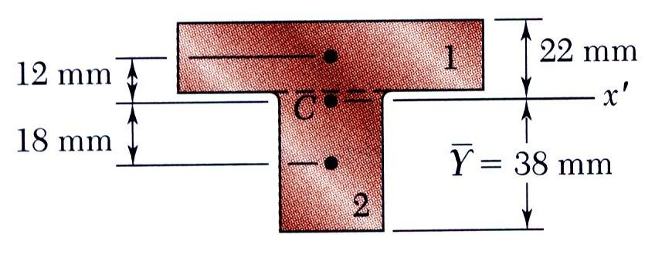
Sample Problem 4.2
SOLUTION:
Based on the cross section geometry, calculate the location of the section centroid and moment of inertia.
 | Area, mm² | y, mm | yA, mm³
1 2 | 20 × 90 = 1800 40 × 30 = 1200 | 50 20 | 90 ×10³ 24 ×10³
 | ∑ A = 3000 |  | ∑ yA = 114 ×10³
Y =
∑ yA 114 ×10³
= = 38 mm
∑ A 3000
I = (I
Ad ) = ( bh + Ad )
2 3
2
∑
∑
1
x′
12
= (
) ( 30 × 40 + 1200 ×18 )
1
3 2
₊ 1
3
2
90 × 20 + 1800 ×12
12 12
I = 868 ×10³ mm⁴ = 868 ×10⁻⁹ m⁴

Slide 11
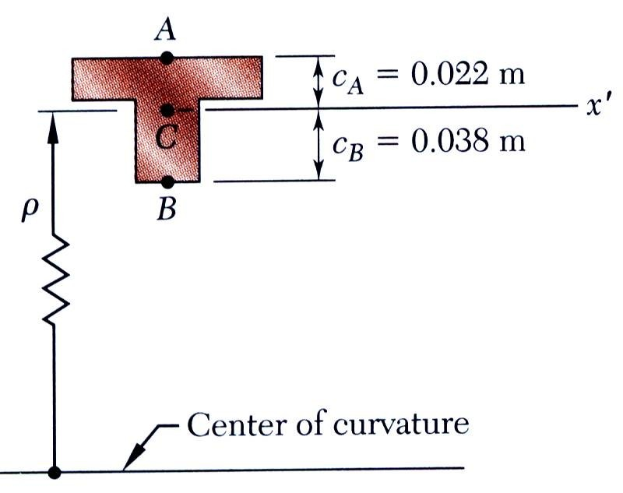
Sample Problem 4.2
Apply the elastic flexural formula to find the maximum tensile and compressive stresses.
_{σ m =} Mc
I
_{σ A =} M c_{A =} 3 kN ⋅ m×0.022 m
σ _{A} = +76.0 MPa
I
868 ×10⁻⁹ m⁴
_{σ B = −} M c_{B = −} 3 kN ⋅ m×0.038m
σ _{B} = −131.3 MPa
I
868 ×10⁻⁹ m⁴
Calculate the curvature
1 ₌ M
ρ EI
3 kN ⋅ m
¹ = 20.95×10⁻³ m⁻¹
=
(165 GPa)(868×10⁻⁹ m⁴ )
ρ
ρ = 47.7 m

